Slide 1

ATTENDANCE MANAGEMENT SYSTEM

Slide 2

PRESENTED BY:
SHIVANI CHAUHAN
SOURAJ MUKHOPADHYAY

Slide 3
OBJECTIVES
Increased operational efficiency.
Reduced operational time.
Maintaining record digitally.
Data security.
This project is used by several users:
Students,teachers,coordinators,
Head of department

Slide 4
MODIFICATIONS OVER EXISTING PROJECT:
Time consumed in accessing the records of the students will be reduced,
Manual manage attendance of students.
Students are informed by sending mail other way to them manually.
Headache of academic cell is more in managing the information of students manually.
More time taken in registration of students on registration forms.

Slide 5
Easy to use GUI.
Time saving
No need to maintain several separate records .
Report of students according to need of Academic cell can be generated easily.
Burden of Academic cell decreases.
ANY DAY ATTENDANCE CAN BE UPDATED
After implementation of project:

Slide 6

TOOLS AND TECHNOLOGIES USED
MYSQL
HTML
PHP

Slide 7
USERS
ADMIN
Add a new user to DB
TEACHER
Update Attendance.
STUDENT
View student details.
Delete a user from DB.
Update values to the DB.
Backup DB.
Reset DB
Upload DB.
Reset Password
Export attendance sheet
Check Attendance.
Update student record.
Check attendance record.
Analyze the attendance feed.
View attendance of class students.

Slide 8

SIGNIFICANCE OF PROJECT:
More trusted environment and no proxy,
A small contribution of ours in saving trees,
Everything is monitored digitally
Parents themselves can check the student performance.

Slide 9
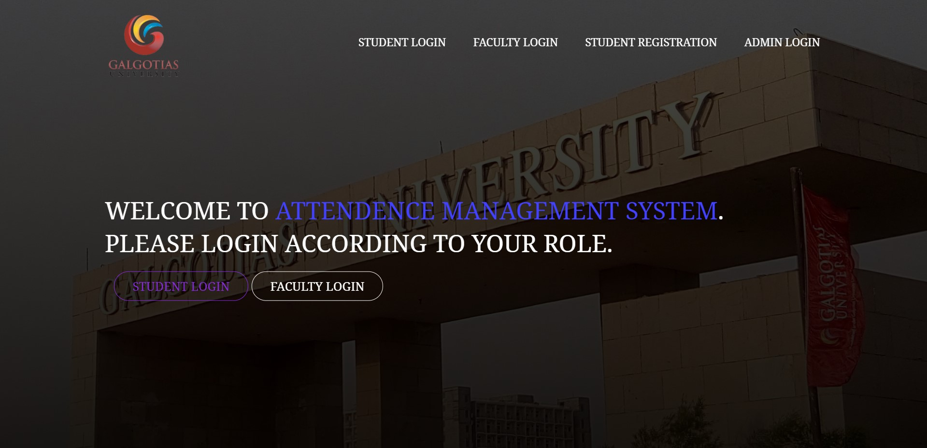
HOME PAGE

Slide 10
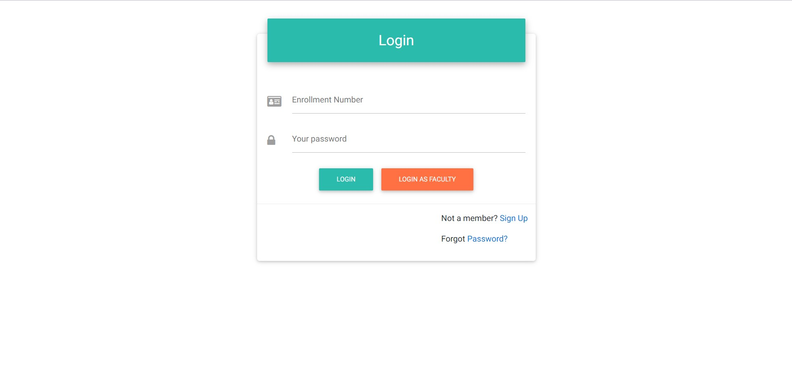
LOGIN PAGE(FOR STUDENTS):

Slide 11
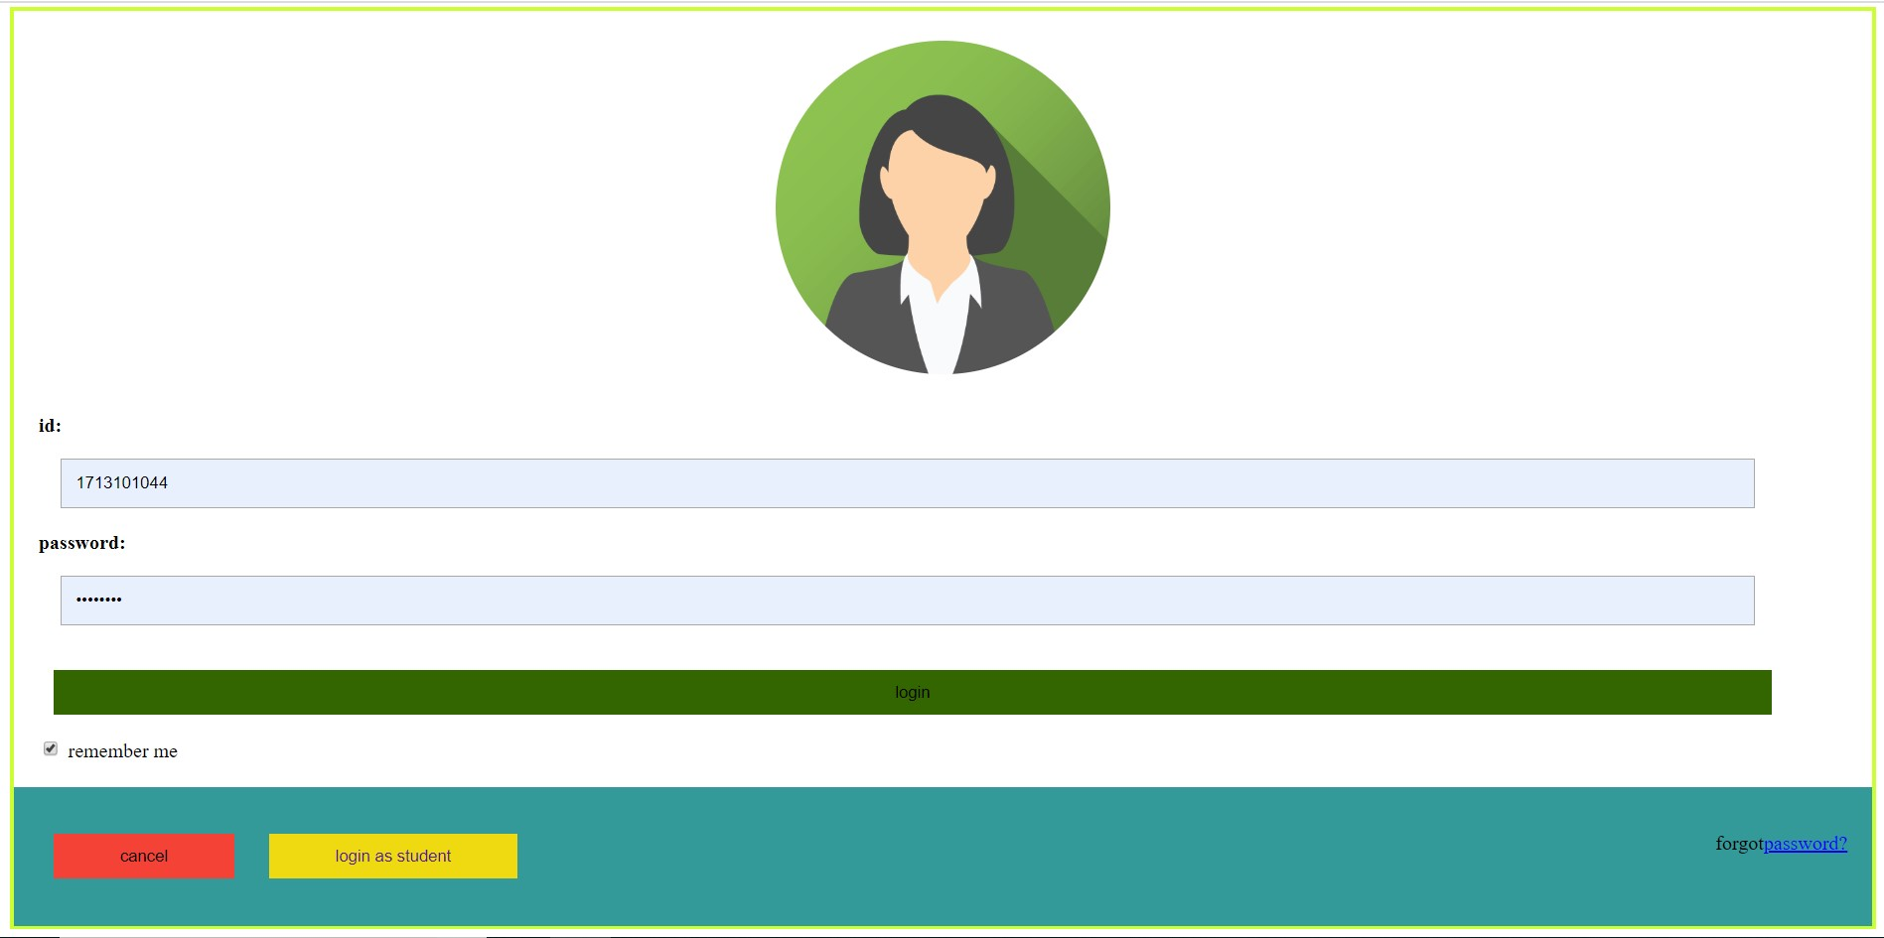
LOGIN(FOR FACULTY):

Slide 12
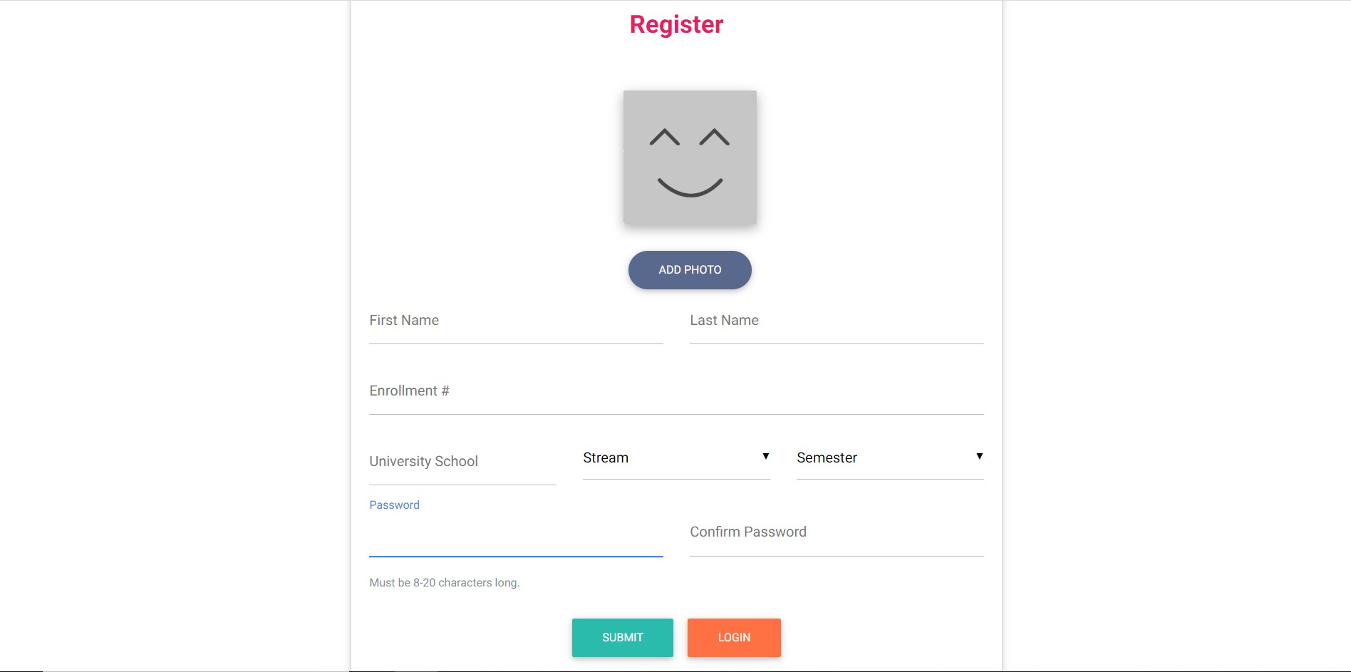
STUDENT REGISTRATION PAGE:

Slide 13
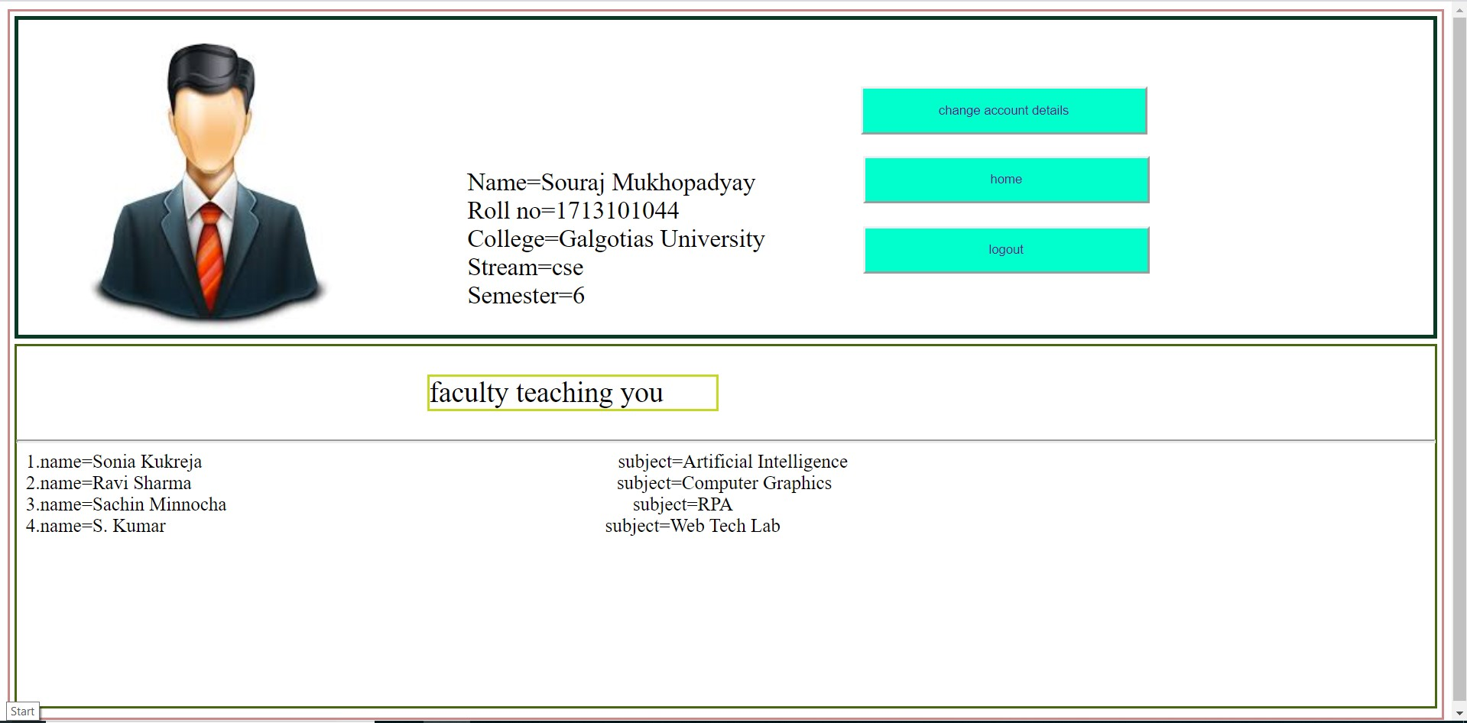
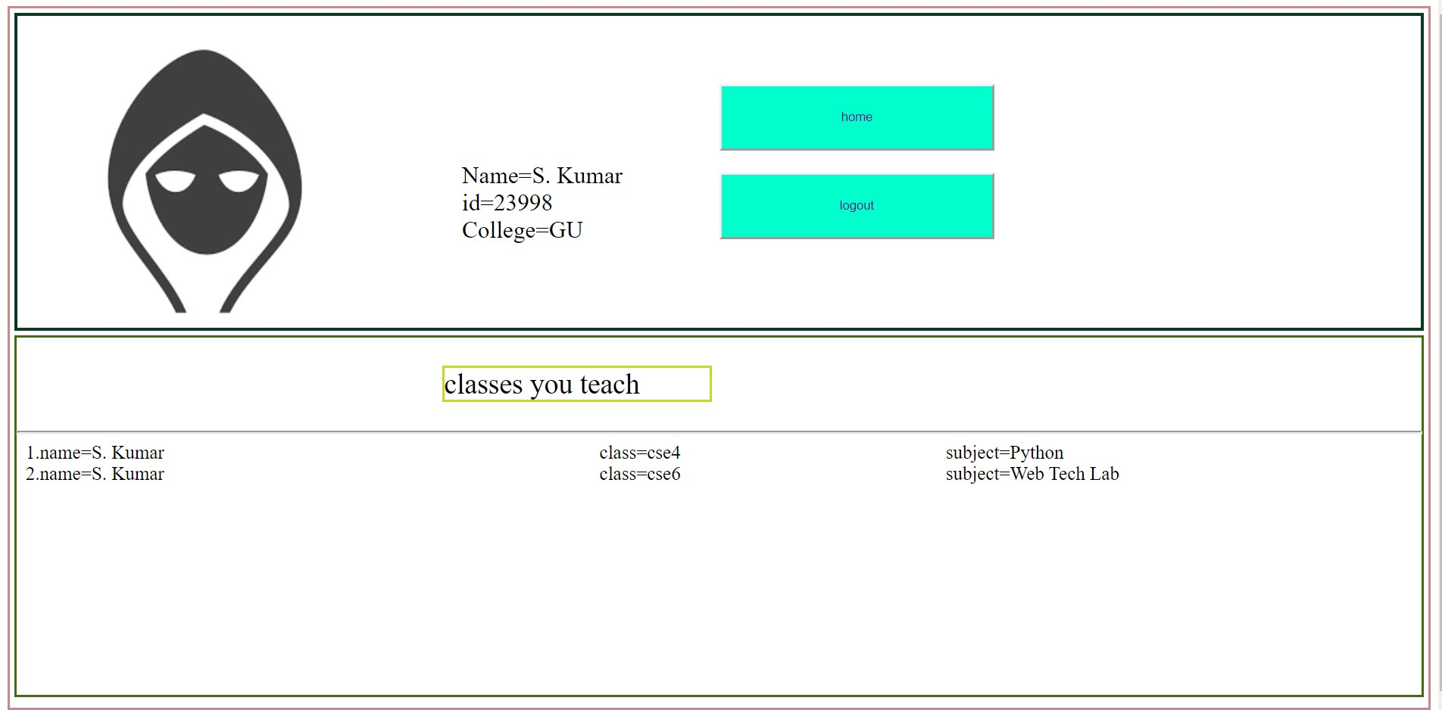
FACULTY PROFILE:
STUDENT PROFILE:

Slide 14
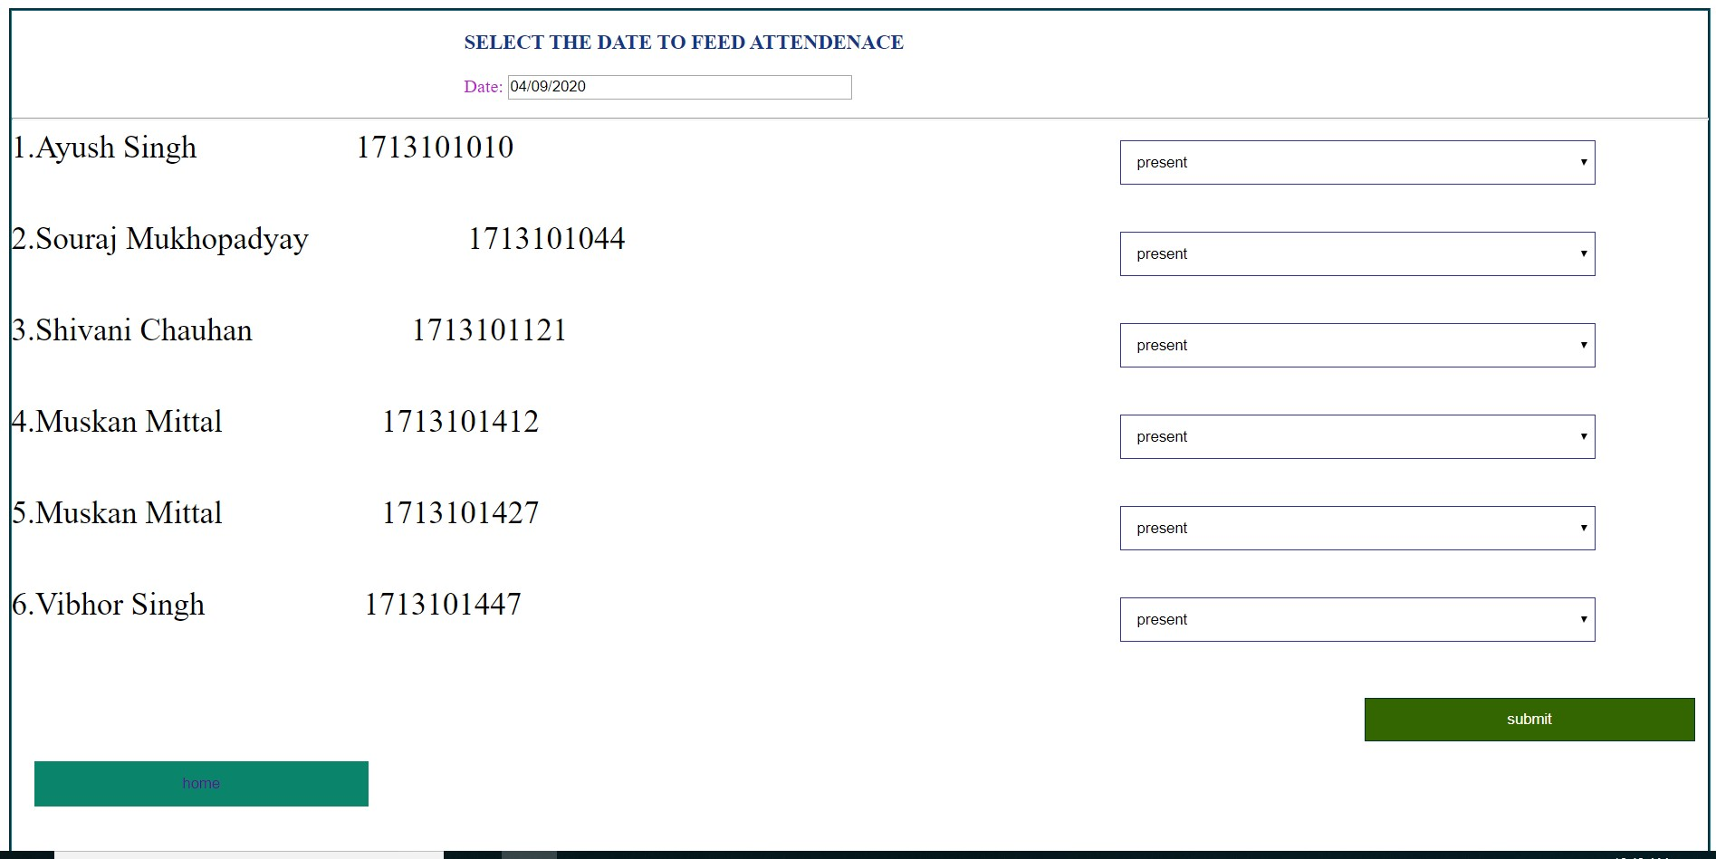
ATTENDANCE FEED:

Slide 15
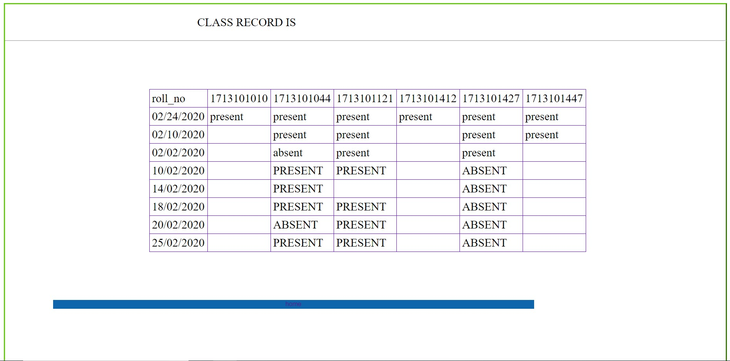
ATTENDANCE RECORD:

Slide 16
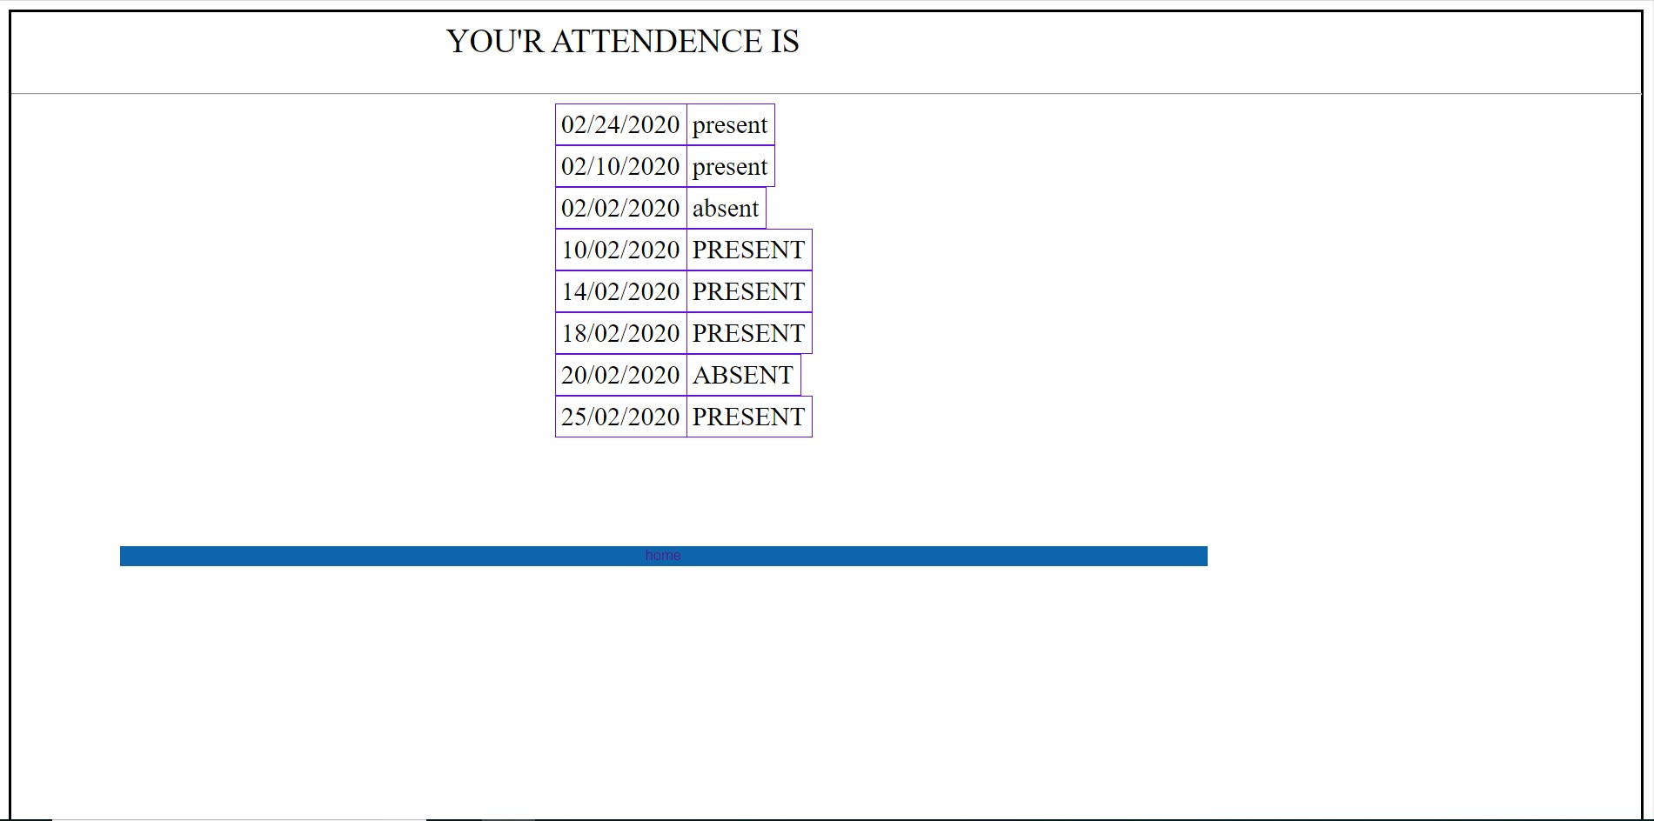
STUDENT ATTENDANCE RECORD:

Slide 17



